Slide 1
Employee Data Analysis using Excel
STUDENT NAME : JEEVANANDHAM H
REGISTER NO :312211516
NAAN MUDHALVAN ID : 22BCOMAF15
DEPARTMENT : BACHELOR OF COMMERCE
COLLEGE : THIRUTHANGAL NADAR COLLEGE

Slide 2
PROJECT TITLE
Employee Attendance or Active and Inactive Analysis using Excel

Slide 3


AGENDA
Problem Statement
Project Overview
End Users
Our Solution and Proposition
Dataset Description
Modelling Approach
Results and Discussion
Conclusion
3/21/2024 Annual Review

Slide 4

PROBLEM STATEMENT record every time an employee is absent, including information such as the date, the time, and the reason. record every time an employee is absent, including information such as the da.

Slide 5

PROJECT OVERVIEW
This project can employee attendance performance of the company through over the financial year in using Excel spreadsheet data

Slide 6





WHO ARE THE END USERS?

Slide 7

OUR SOLUTION AND ITS VALUE PROPOSITION Conditional formatting -Highlight row & column Filter -Sperate active & inactive Formula -Attendence analysis Pivot table -Summarize information Excel –Data visualization

Slide 8
Dataset Description Employee Dataset - From Edunet Dashboard Available Features - 50 Necessary Features- 26 Employee Id - In Number Name - In text Performance Level – In text Gender - Male, Female Employee Attendance - In Date format

Slide 9
MODELLING
A. Data Collection
Gather data on employee attendance, including dates, times, reasons for absences, and any relevant context (e.g., weather conditions, personal issues).
9

Slide 10
B. Feature Collection 1) Select key features (e.g., employee id, gender, start date, end date). C. Data Cleaning 1) Highlight incomplete records through conditional formatting. 2) Remove blanks data using filter. 3) Data comparative using the filler and using border of the excel sheet.

Slide 11
D. Performance Level 1) Define Attendance level (Active and Inactive) based on edunet given data. 2) Assign the two categories of employees attendance performance level. E. Summary 1) Summarize key findings from the data preparation. 2) Pivot table setup by add gender, start date , end date , active , inactive .

Slide 12
F. Visualization 1) After set up of pivot table select the type of chart (e.g., pivot table) for comparing employee Attendence performance level. Purpose: Compare two different pivot table of the employee performance. Insights: Easily identify which employee is active and inactive .

Slide 13
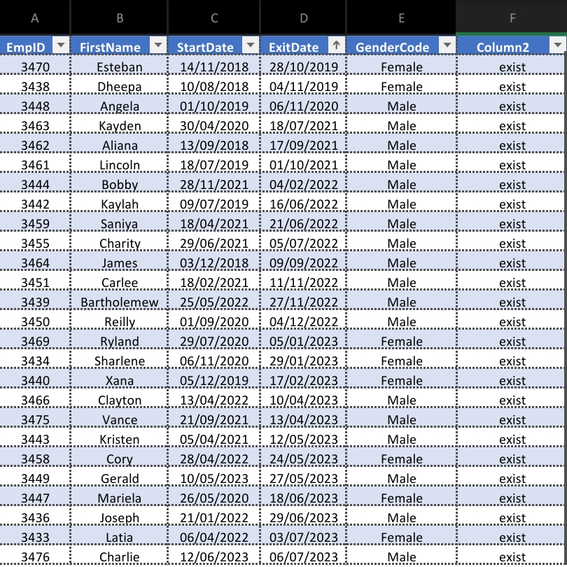
RESULT 1
13

Slide 14
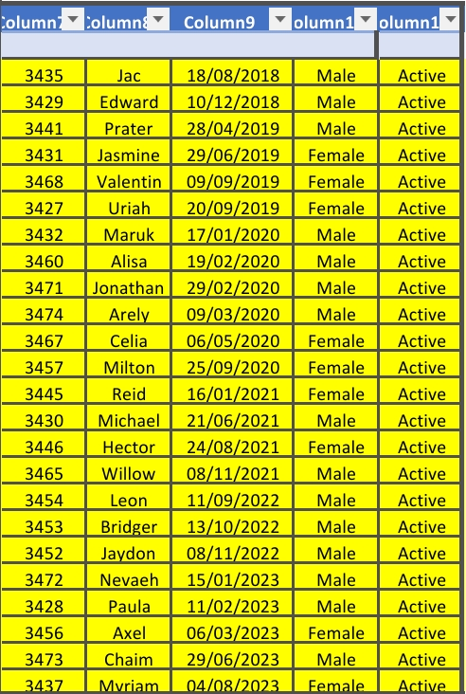
RESULT 2
Result 2 is active employee of the data

Slide 15
Conclusion From this Employee Attendance performance analysis, most of the employee exist of the company in given data. From the result 2 compare than result 1 data are employee exist in company in given data.

Slide 16
Thankyou

